Slide 1
BUILDING AN INTELLIGENT DESKTOP VOICE ASSISTANT USING NLP AND AI
BY
K.ABHINAY

Slide 2
INTRODUCTION
The usage of voice assistant is expanding rapidly after 2017, more and more products are coming into the market.
Voice Assistant is a program, to develop and design to assist the user with basic tasks.
It takes voice as the input through user microphone to provide various services.
It’s working depends on technologies like speech recognition, speech synthesis combined with natural language processing.

Slide 3
INTRODUCTION
Natural language processing is subset of Artificial Intelligence.
It gives computer ability to understand Text or Speech.
Voice Assistant requires microphone for taking user input and relatable internet connection for solving tasks.

Slide 4
PROBLEM STATEMENT
To Design and implement the program to build an Intelligent Desktop Voice Assistant using NLP and AI.
OBJECTIVES
To aim the technologies for solving some real-world problems.
To provide timely and precise results at certain voice commands
To give user hands-free access to many functions.
To save the time by performing required tasks more efficiently.

Slide 5
LITERATURE SURVEY
Home Automation using Voice Commands
Objective was to implement the dedicated hardware system by using voice recognition module.
This proved the system more cost-efficient and robust.
The system was able work on various connected devices.

Slide 6
LITERATURE SURVEY
Voice based E-Mail for the Blind
The system that was helpful for sending emails for the blind people without the need of visual interaction.
Speech-to-Text based system for smartphones.
The voice is collected from microphone of smartphone,

Slide 7
PROPOSED APPROACH
To use the Task-oriented approach and Knowledge-oriented approach for execution.
Task-oriented approach
A task-oriented approach uses system calls to achieve what the user need.
For example: Opening desktop application

Slide 8
PROPOSED APPROACH
Knowledge- oriented approach
Knowledge-oriented approach uses APIs for getting the result.
This process requires internet connection.
For example: Getting answer for question

Slide 9
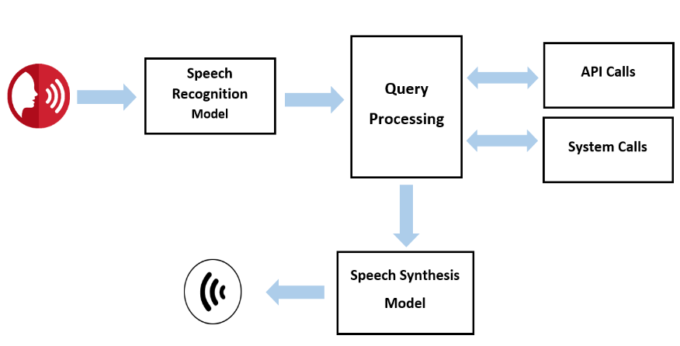
SYSTEM ARCHITECTURE
Fig – Workflow of Voice assistant

Slide 10
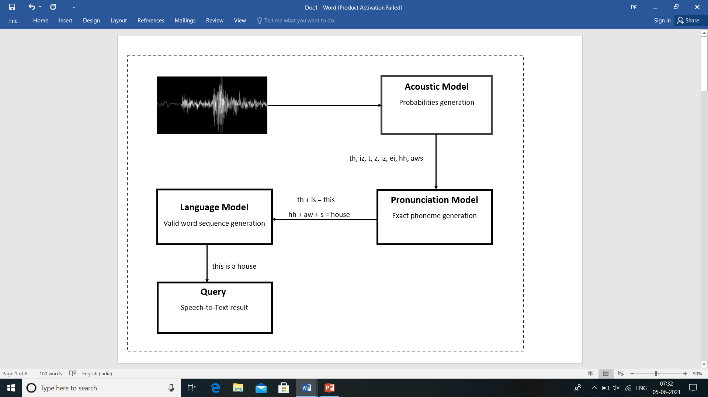
SYSTEM ARCHITECTURE
Fig – Architecture of speech recognition model

Slide 11
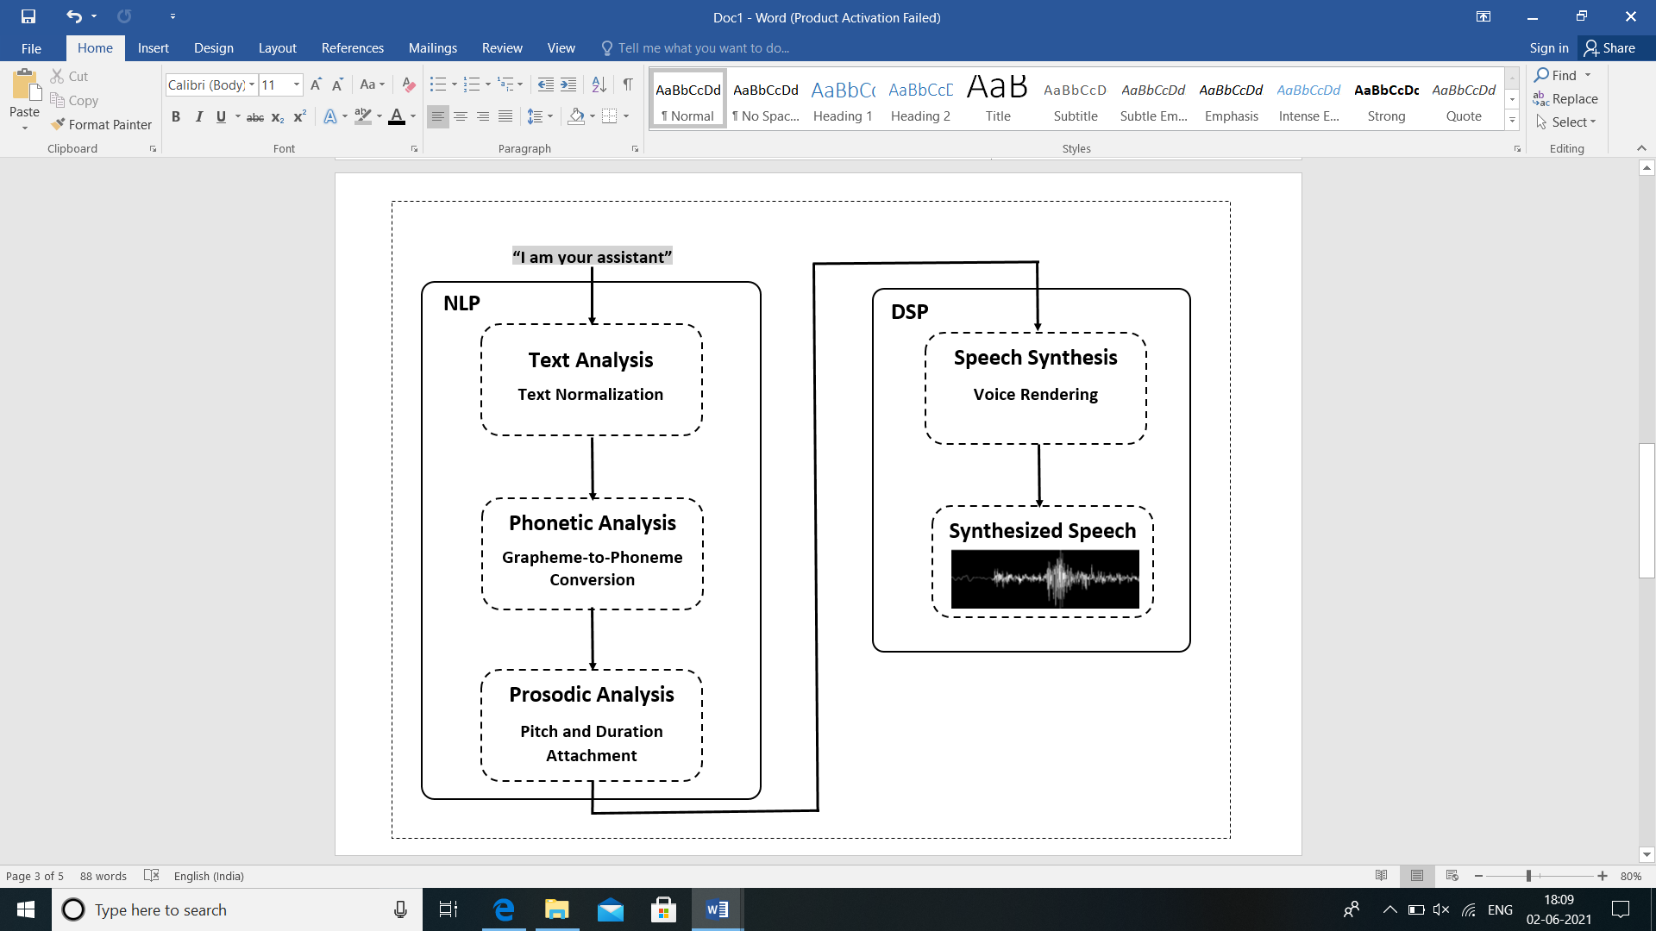
SYSTEM ARCHITECTURE
Fig – Architecture of speech synthesis model

Slide 12
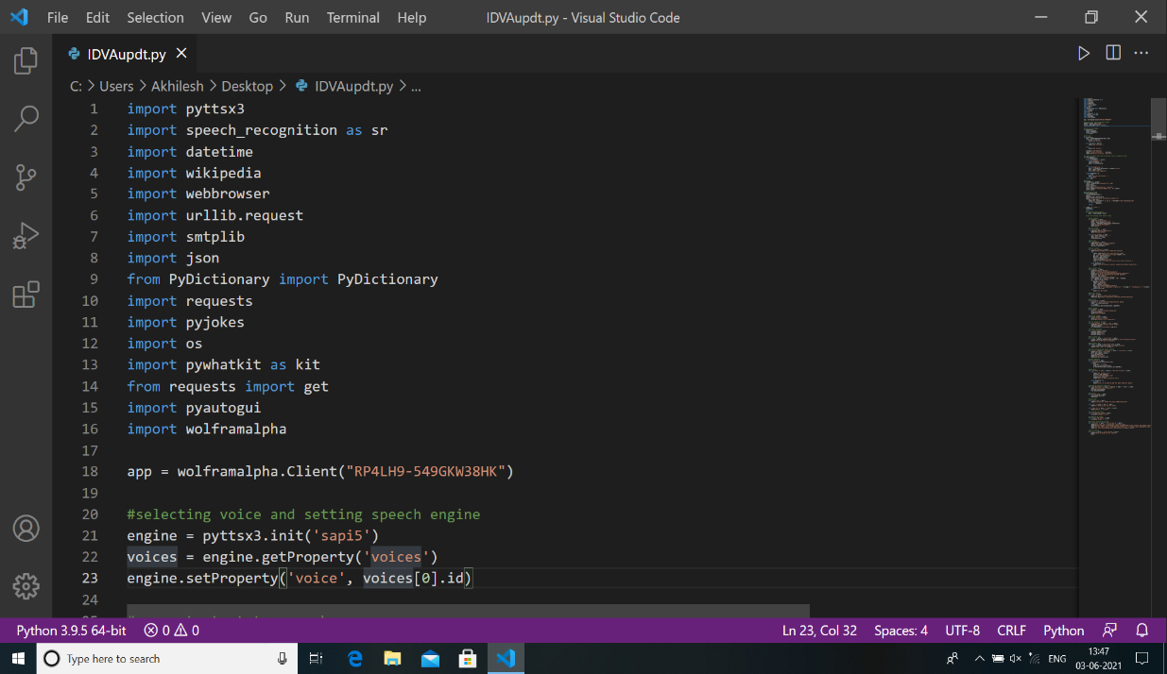
IMPLEMENTED WORK
Stage 1 Implementation
Installation of Python modules

Slide 13
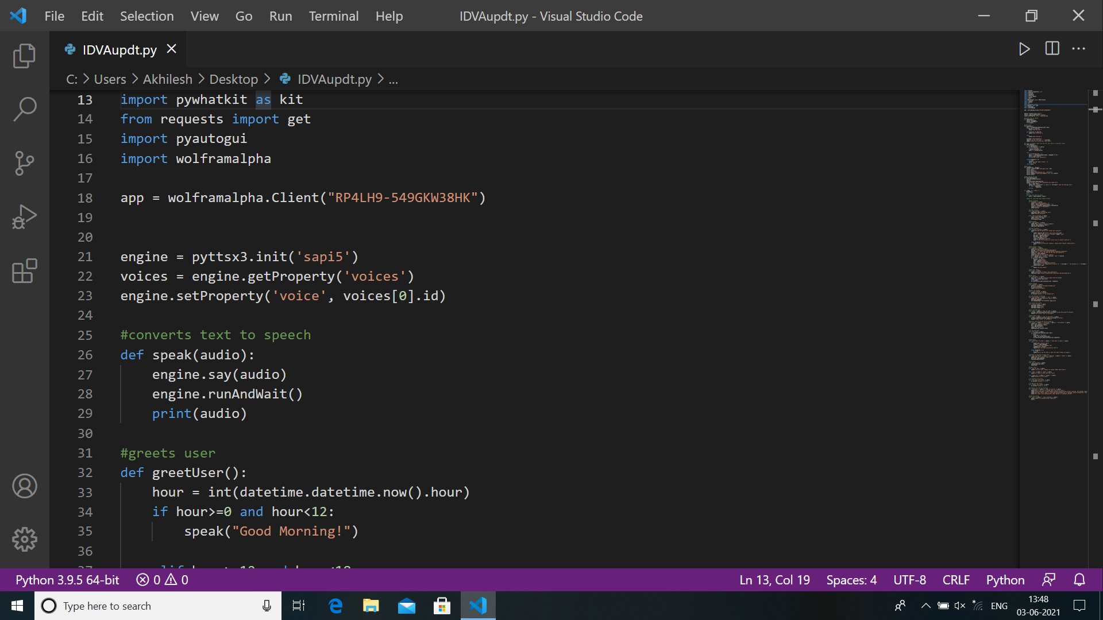
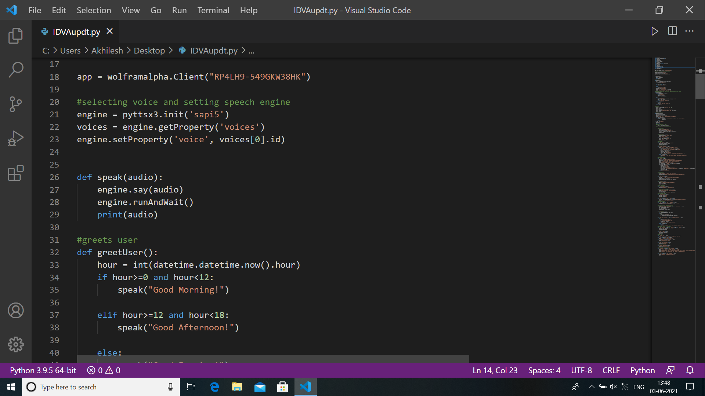
IMPLEMENTED WORK
Stage 2 Implementation
Assigning voice for assistant

Slide 14
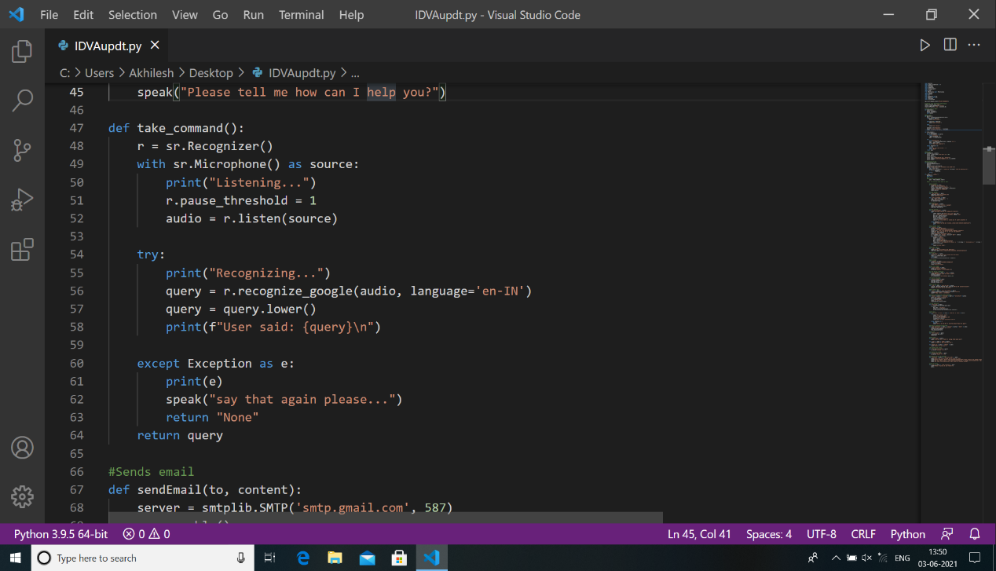
IMPLEMENTED WORK
Stage 3 Implementation
Collecting voice input

Slide 15
IMPLEMENTED WORK
Stage 4 Implementation
Developing code for handling commands and exceptions
Decision making is required for performing functions.
Implementation based on detection if the keyword in query
Stage 5 Testing and Debugging
The testing is done for different test-cases.
Further advancement made in function, if required.

Slide 16
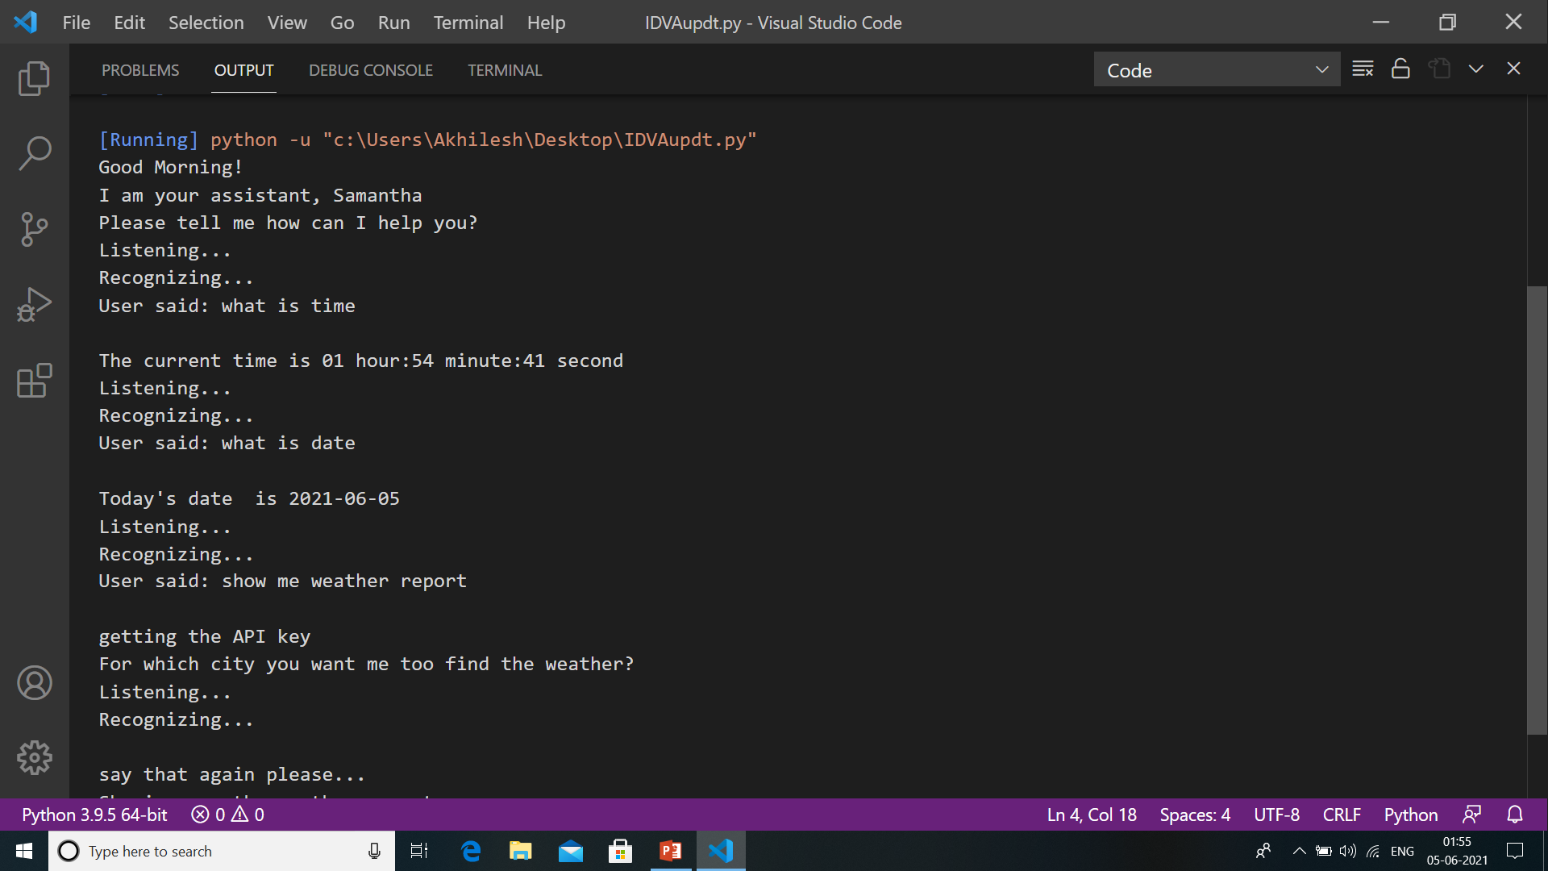
RESULTS AND DISCUSSIONS
Getting time and date:

Slide 17
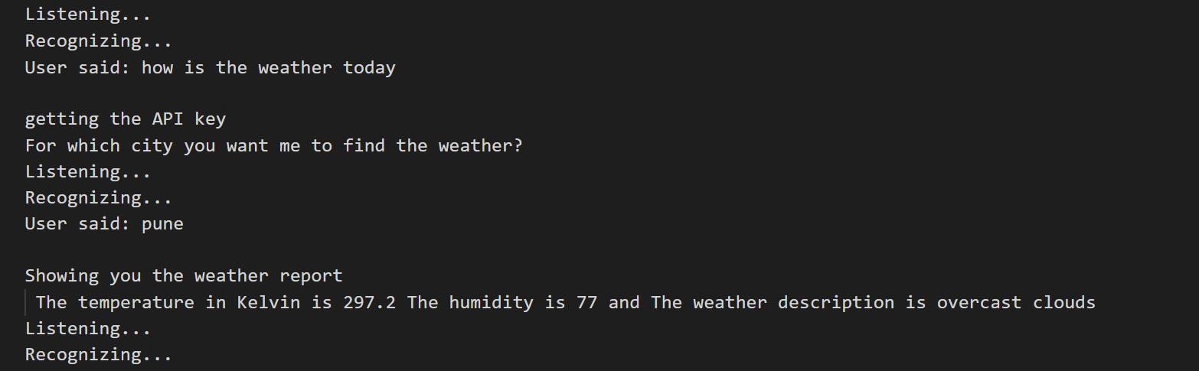
RESULTS AND DISCUSSIONS
Getting weather report :

Slide 18
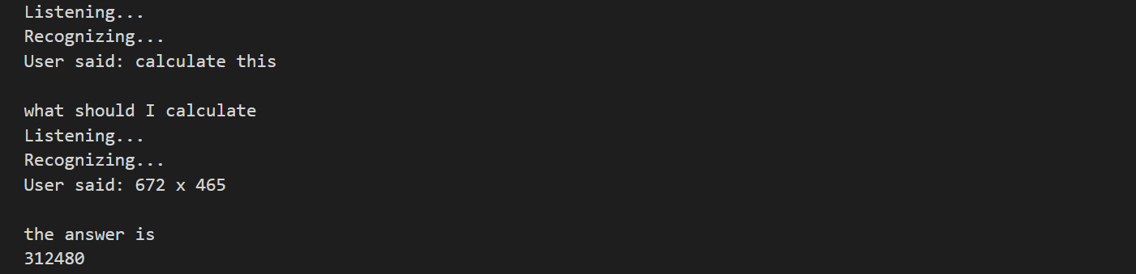
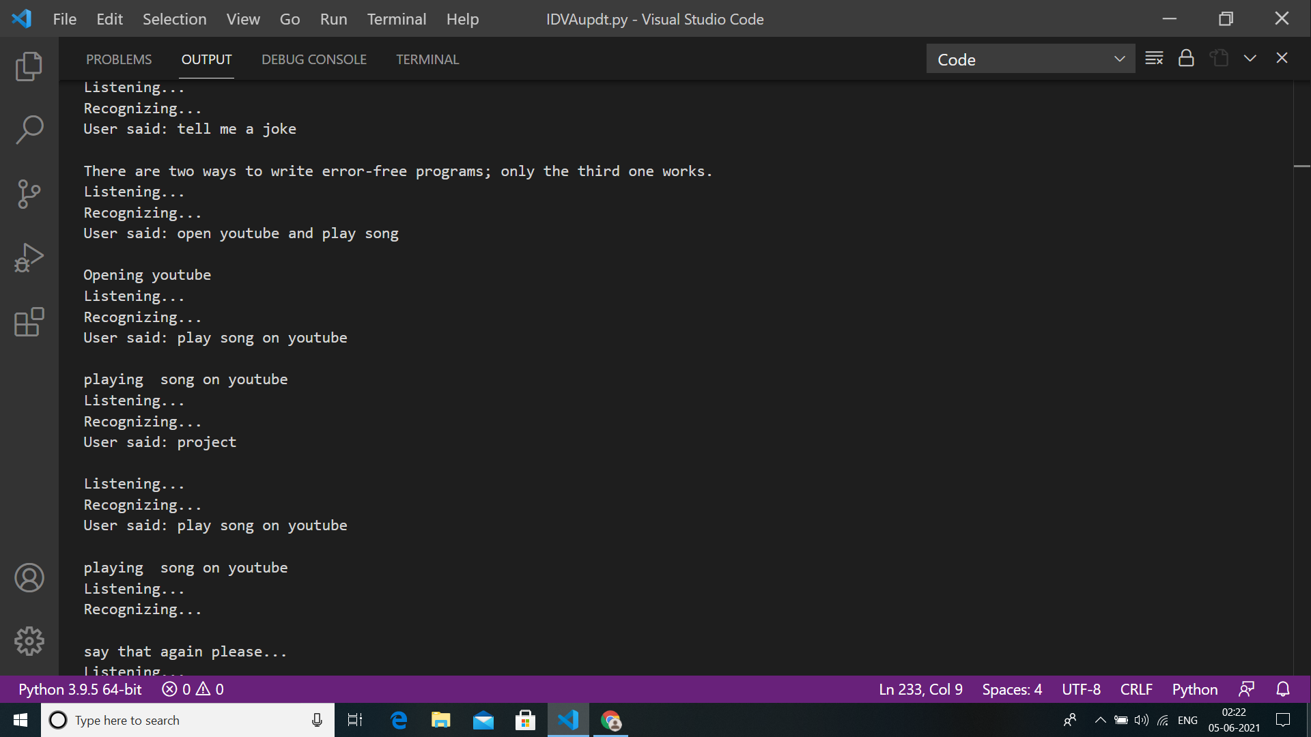
RESULTS AND DISCUSSIONS
Doing calculations :
Asking for joke :

Slide 19
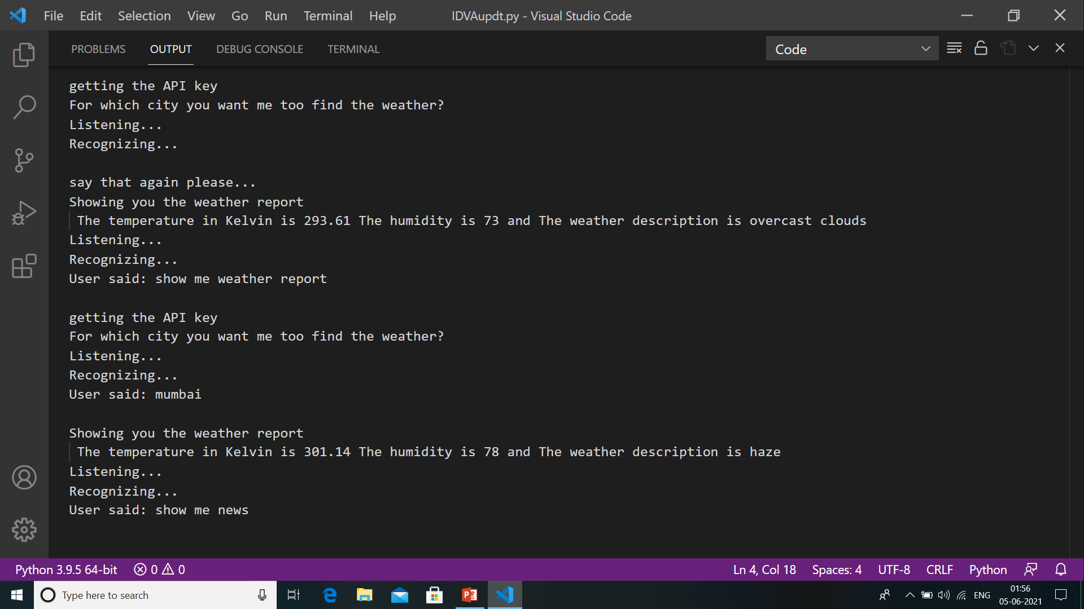
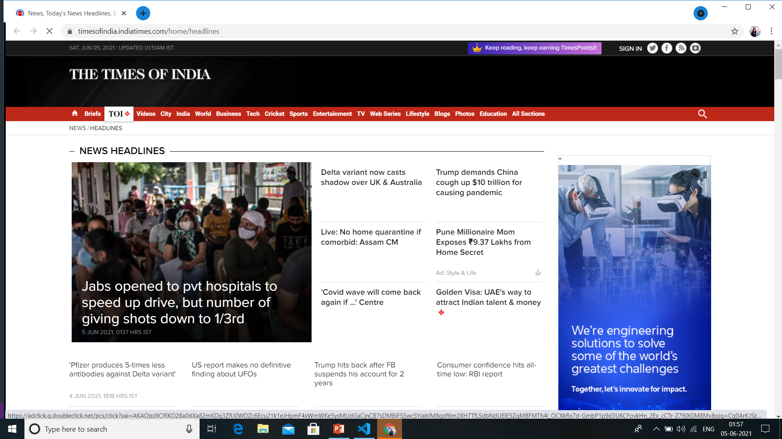
RESULTS AND DISCUSSIONS
Getting news report :

Slide 20
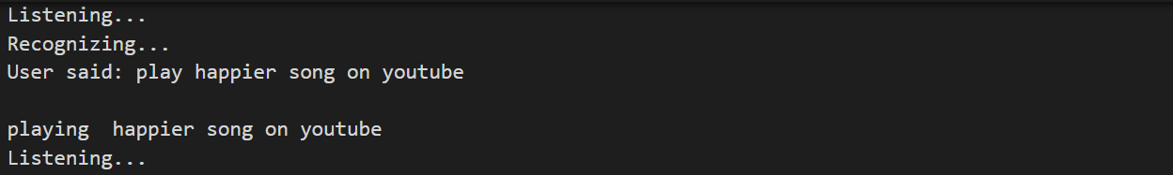
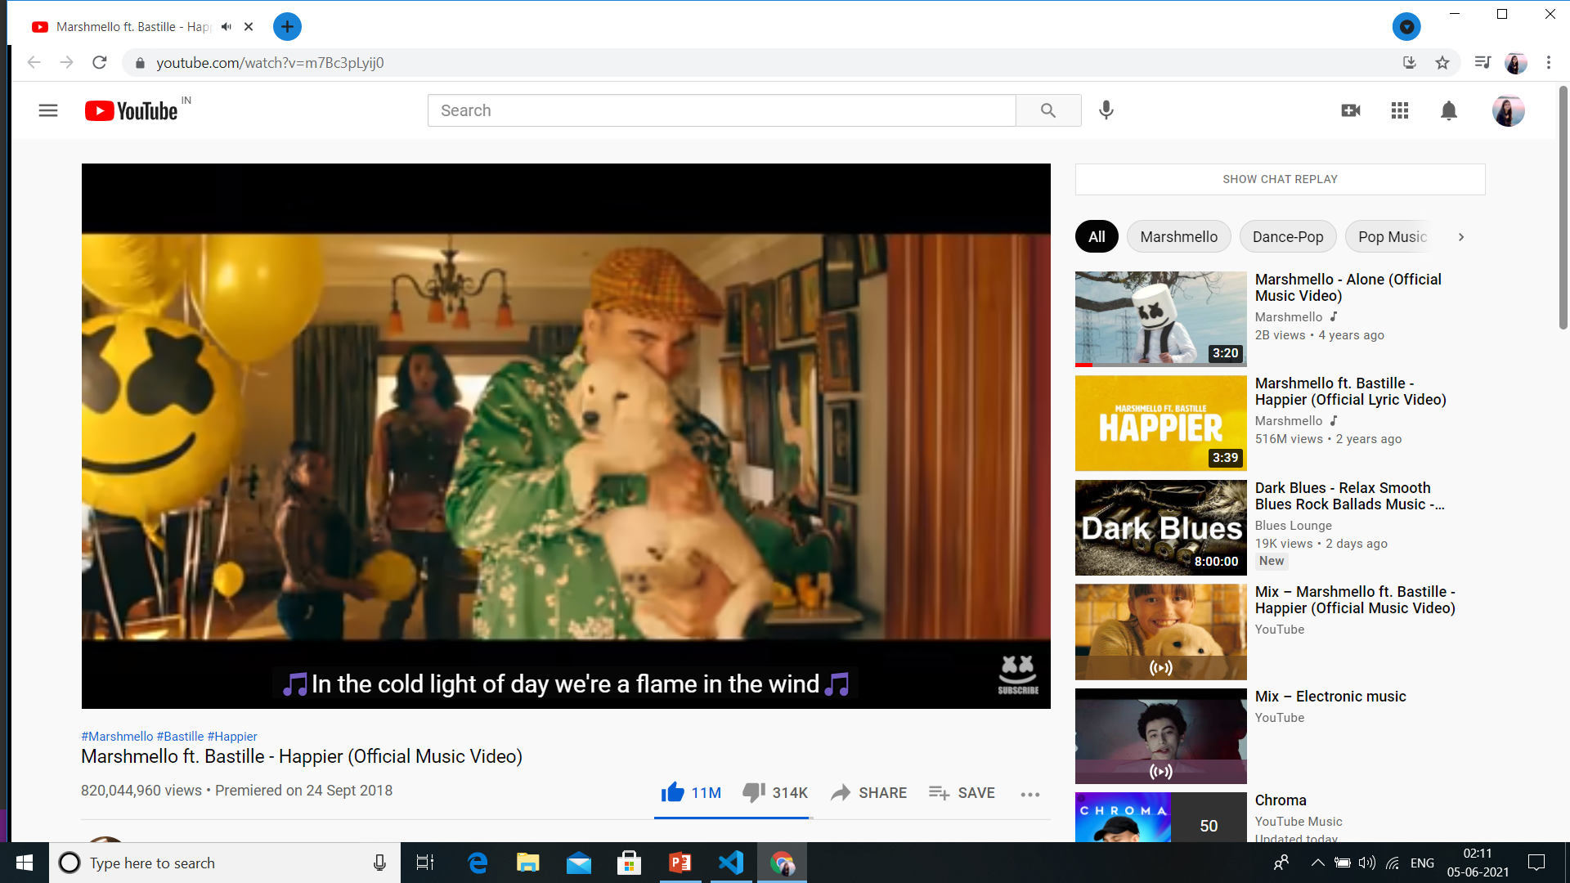
RESULTS AND DISCUSSIONS
Playing song on YouTube :

Slide 21
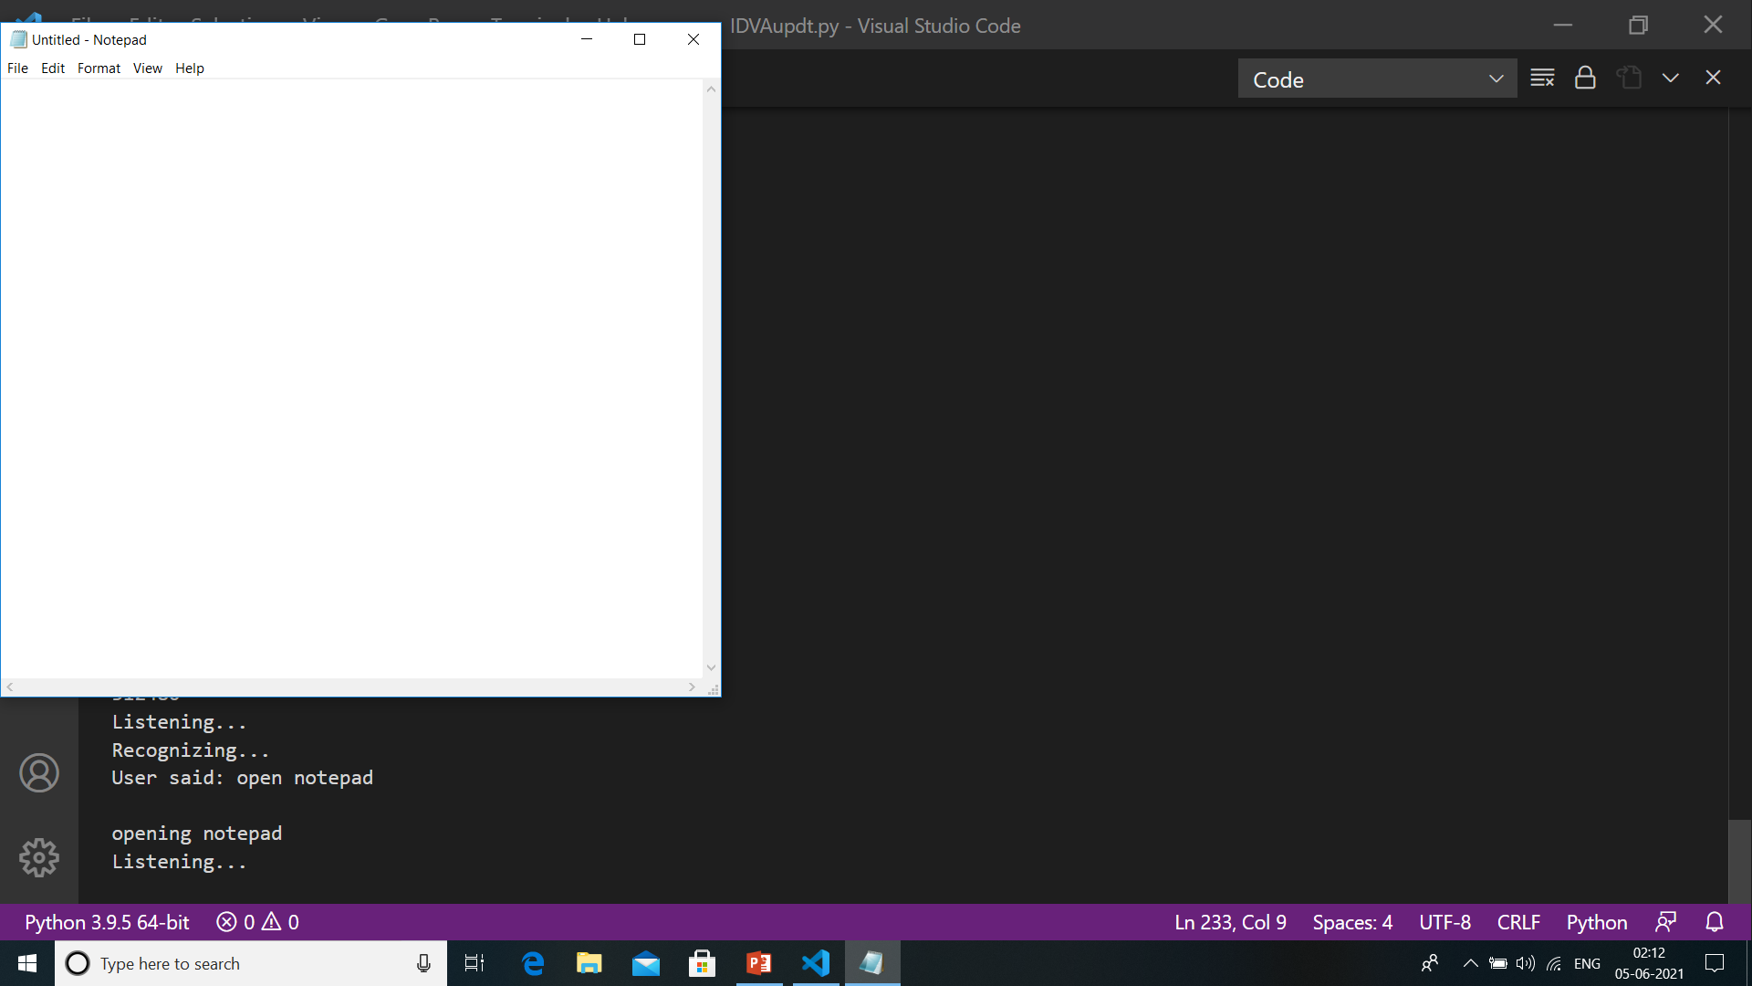
RESULTS AND DISCUSSIONS
Opening notepad :

Slide 22
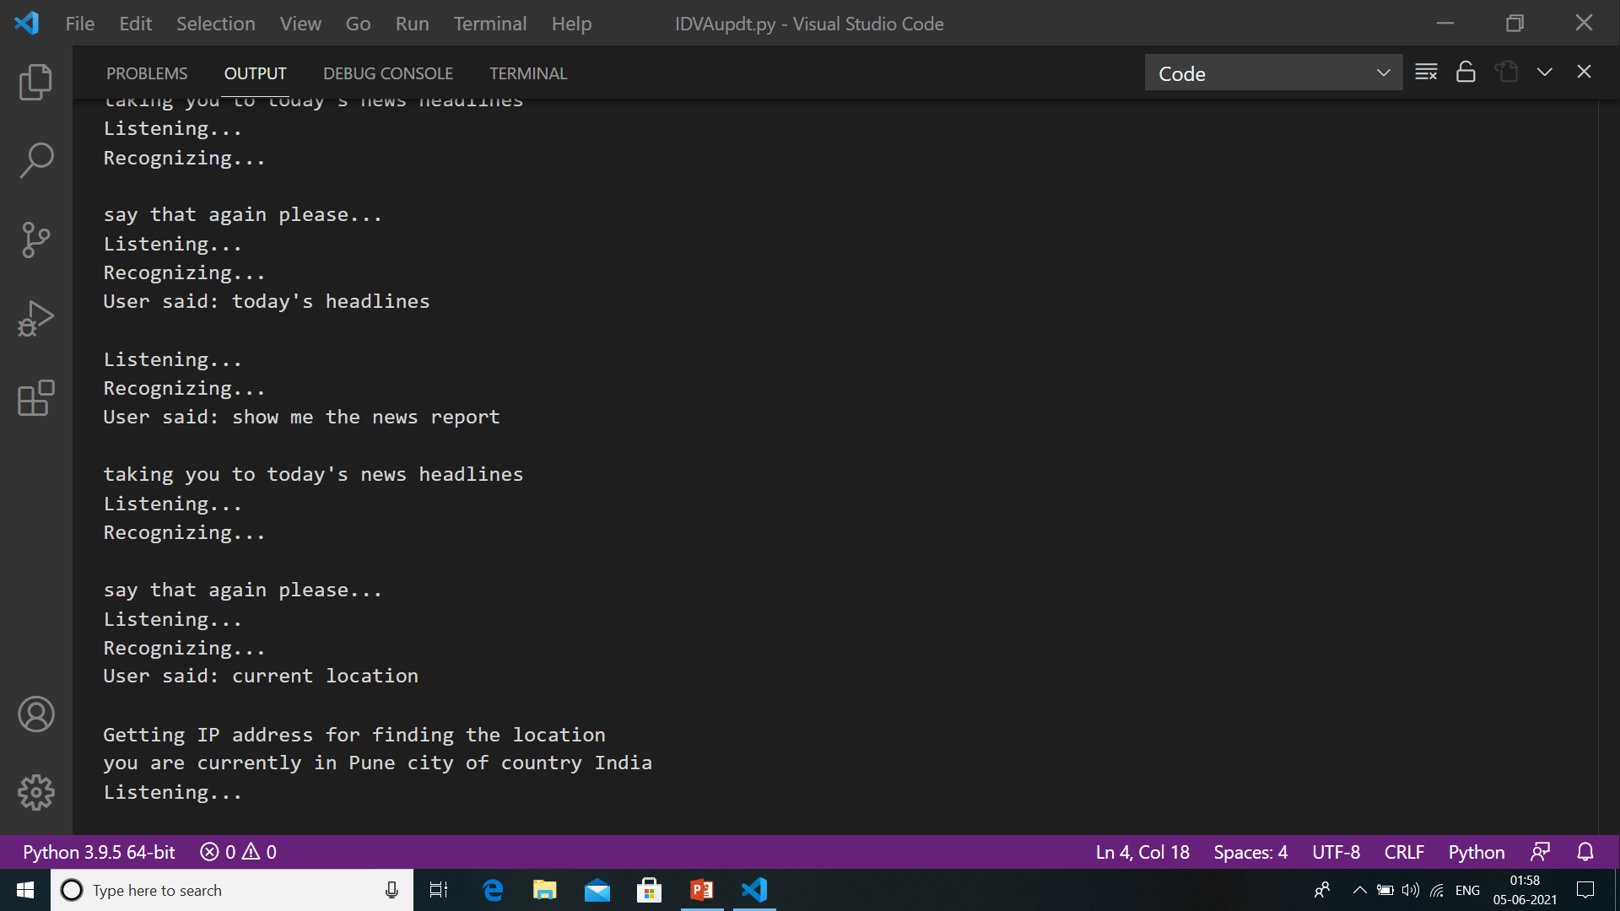
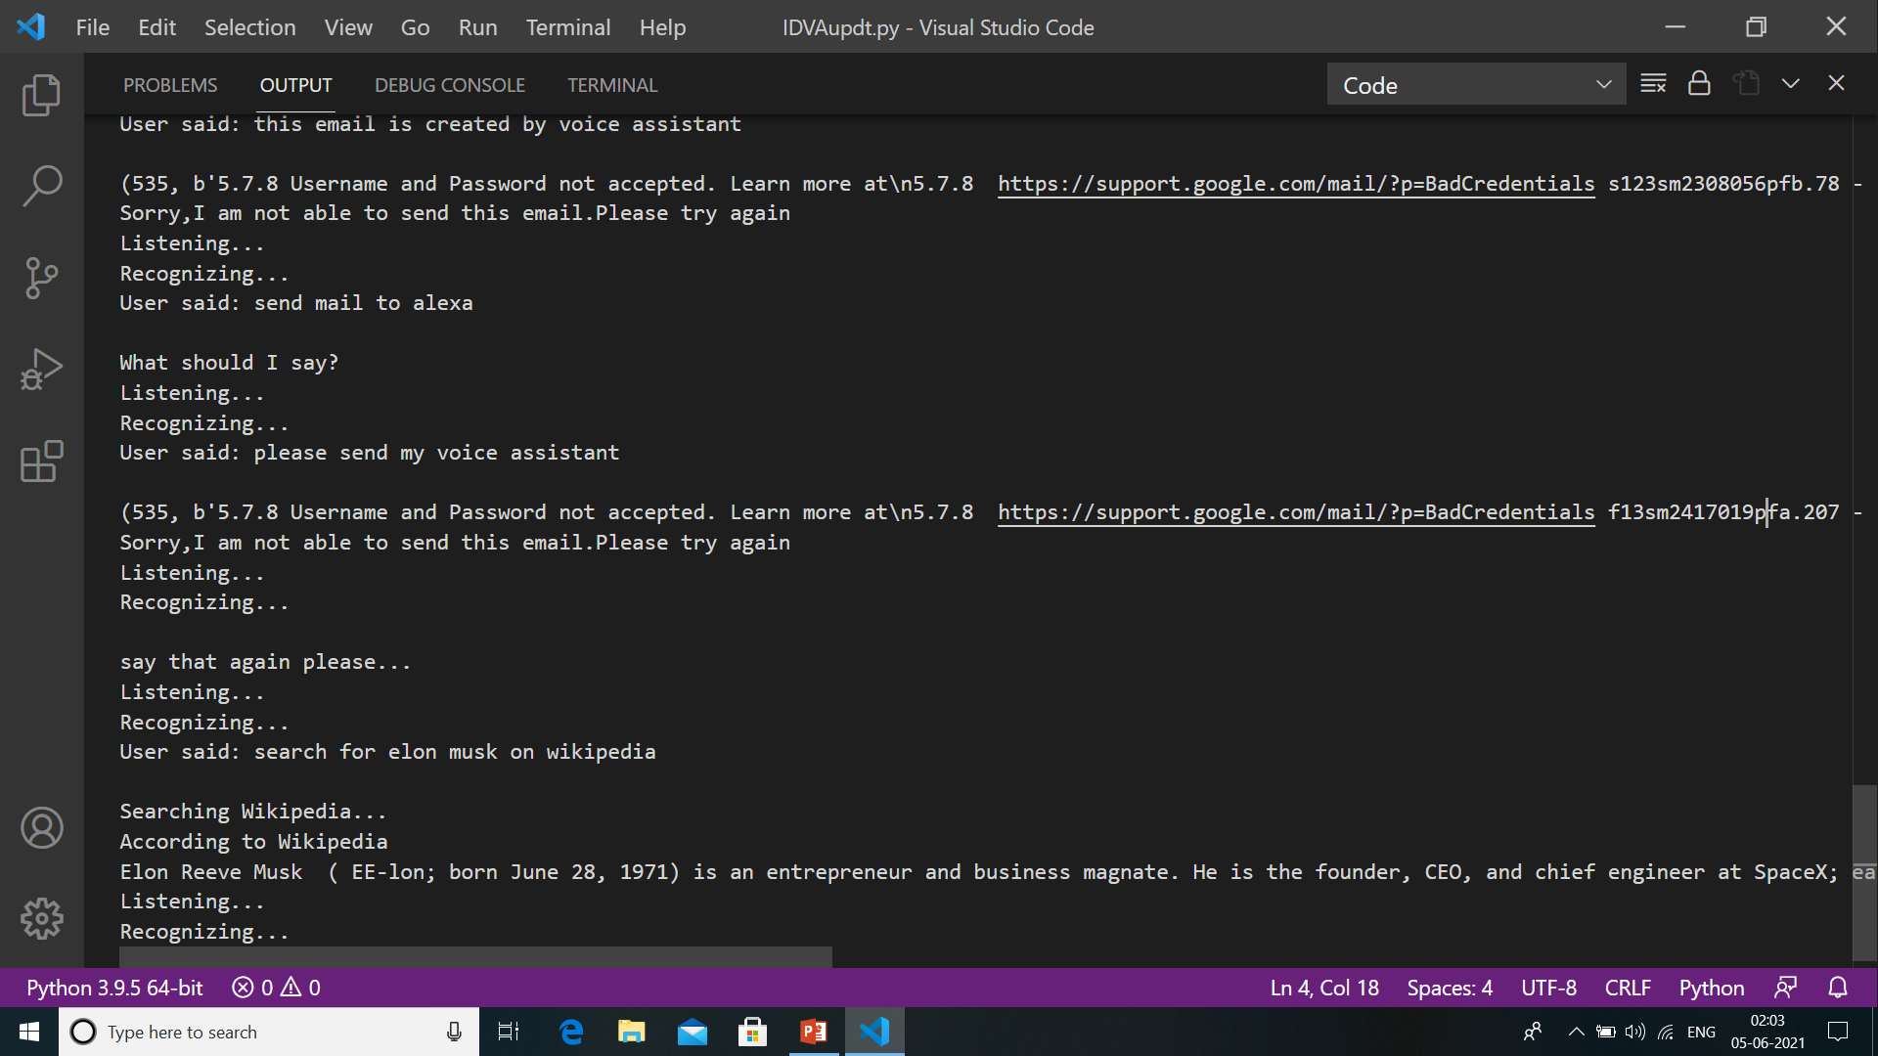
RESULTS AND DISCUSSIONS
Getting current location :
Accessing Wikipedia :

Slide 23
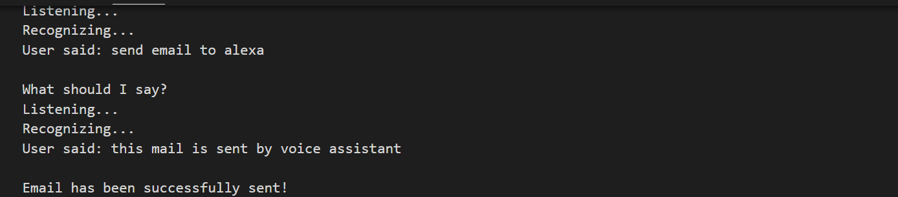
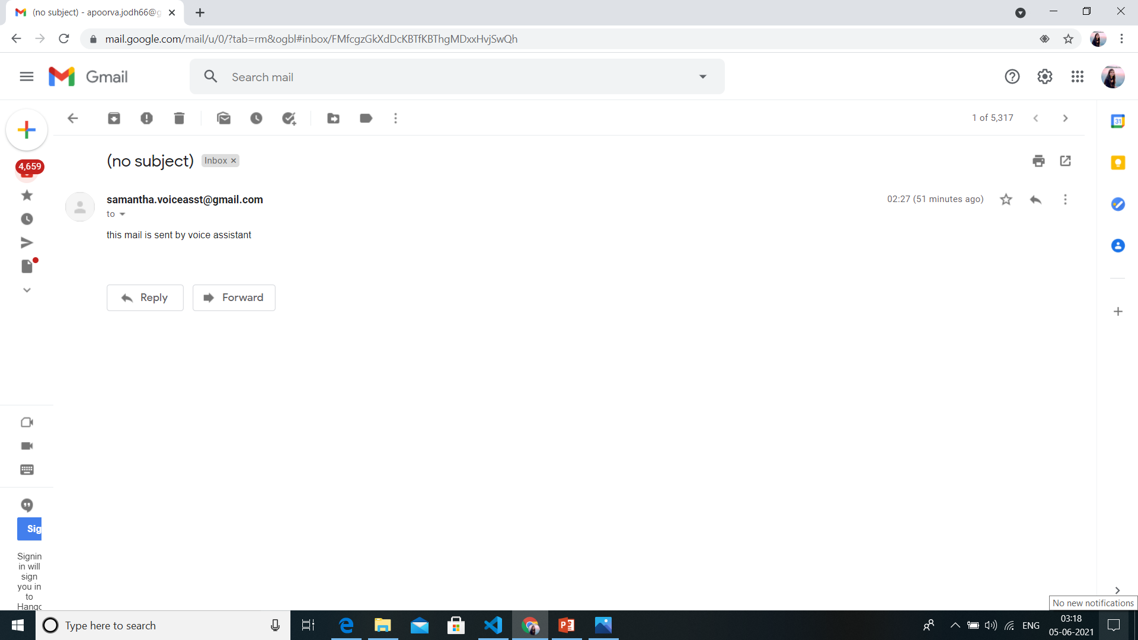
RESULTS AND DISCUSSIONS
Sending Email :

Slide 24

RESULTS AND DISCUSSIONS
Terminating the session :

Slide 25
CONCLUSION
This system is designed in such a method where in the user can accommodate to any task effortlessly.
The modular nature of this project makes it flexible and easy to add additional features without disturbing current system functionalities.
Various features are performed successfully just on voice command.

Slide 26
FUTURE SCOPE
Time is not issue with the voice assistant. It can be used 24*7. Thus, are more preferable in businesses for having human-like interaction with customers.
It can be personalised according to the user’s requirement. Thus can be used in most of the sectors,
The continuous growth in Natural language processing field will give higher accuracy rate with minimum efforts.

Slide 27
REFERENCES
https://ieeexplore.ieee.org/document/9051160
https://towardsdatascience.com/understanding-nlp-how-ai-understands-our-languages-77601002cffc
https://journals.ala.org/index.php/ltr/article/view/7361/10126
Prerna Wadikar, Nidhi Sargar, Rahool Rangnekar, Prof. Pankaj Kunekar “Home Automation using Voice Commands in the Hindi Language”, 2020, IRJET
Steve Joseph, Chetan Jha, Dipesh Jain, Saurabh Gavali, Manish Salvi “Voice based E-Mail for the Blind”, 2020, IRJET.

Slide 28
THANK YOU

